Slide 1
Eve Kit Software Installation
Michael Clayton
December 23, 2024

Slide 2
Contents
For INFORMATION
For DIRECTION
For DECISION
TSP Information
Logistic Information
Procedure
Appendix
X
X
X
X

Slide 3
TSP-J-5014
Eve Kit Software Installation
N/A
N/A
N/A
N/A
No
240
N/A
N/A
N/A
Yes
4.0
No
0.5
N
12/23/2024
Michael Clayton
N/A
Rafael Guillen
N/A
Chris Lewandowski
Converted to the NEW 5080 PPT format

Slide 4
Ryan Bednar
8/28/2024
Michael Clayton
8/28/2024

Slide 5
Technician/s Needed to Perform Test: 1
Location where Test will/can be performed.
Lab/Room 1 - # of Days Required
Hardware Needed
Eve kit
Battery box
External monitor with HDMI and Power
Keyboard
USB Storage Device
Computer interface needed
CANoe
CANape
Vector Hardware Configurator
Vector Hardware Manager
Google Chrome

Slide 6
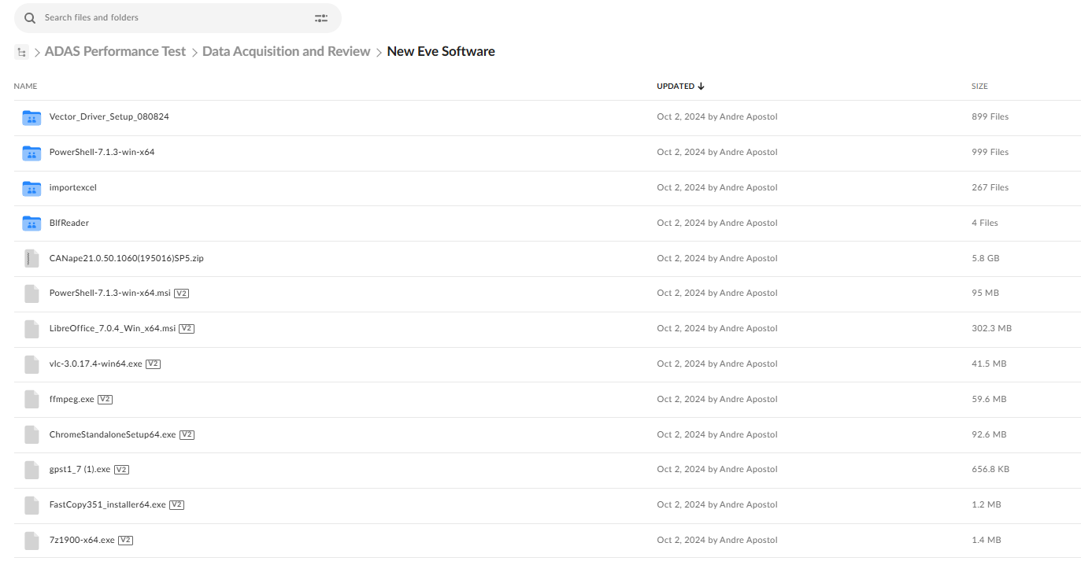
60
Basic Setup
Step | P R O C E D U R E
1 | Contact ADAS team to acquire all the necessary items needed to complete the software installation
2 | Download “New Eve Software” This can be found on Box https://nissan-usa.app.box.com/folder/287207437413?s=onrog3vgklgdjttm8c3rjm1cdx400h1e If you are unable to download the folder, a team member will be able to assist (Photo # 1)
1

Slide 7
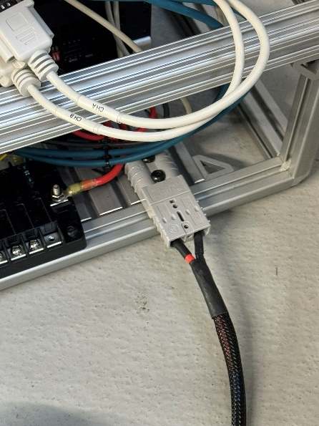
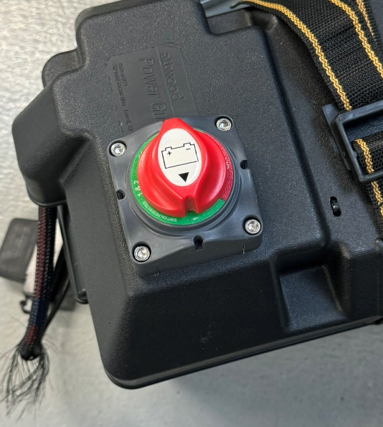
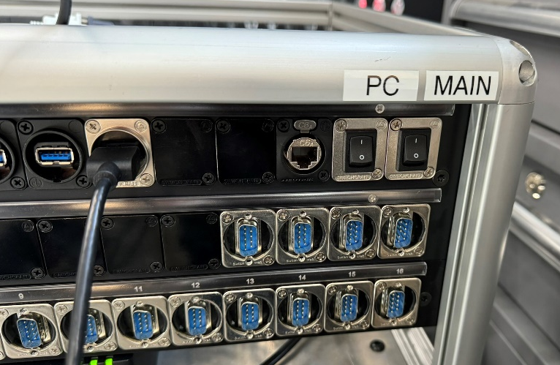
5
Basic Setup
Step | P R O C E D U R E
3 | Plug in battery Anderson connector to Anderson connector on the lower right of the Eve Kit. (Photo # 2) Plug in monitor to HDMI slot on patch panel and any monitor power to USB slot. (Photo # 4) Plug in keyboard and storage device into USB slot on patch panel. (Photo # 4)
4 | Turn battery on. (Photo # 3) Turn Main power rocker on and wait 2-3 seconds. (Photo # 4) Turn PC power rocker on. (Photo # 4)
4
2
3

Slide 8
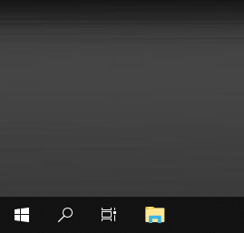
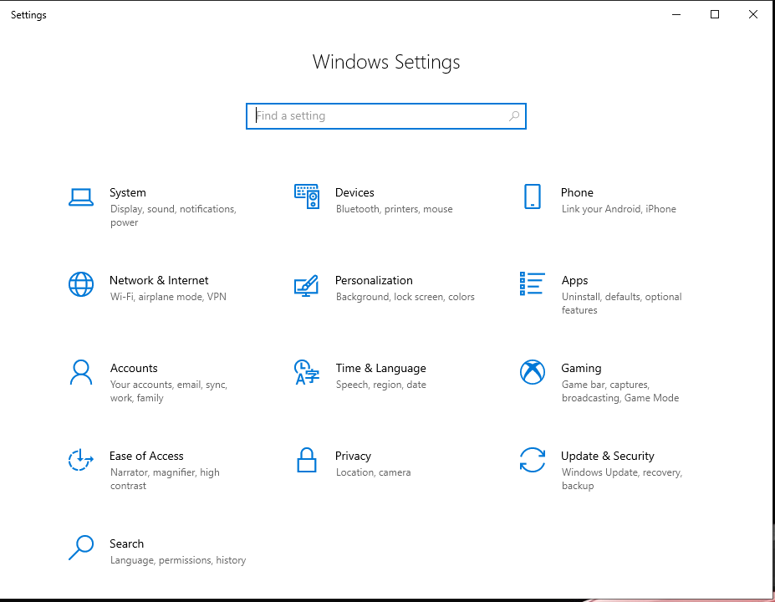
1
Basic Setup
Step | P R O C E D U R E
5 | Search for “File Explorer” right click and choose “Pin to Taskbar” (Photo # 5)
6 | Search for Settings Once in the Settings Window select “Time and Language” (Photo # 6)
5
6

Slide 9
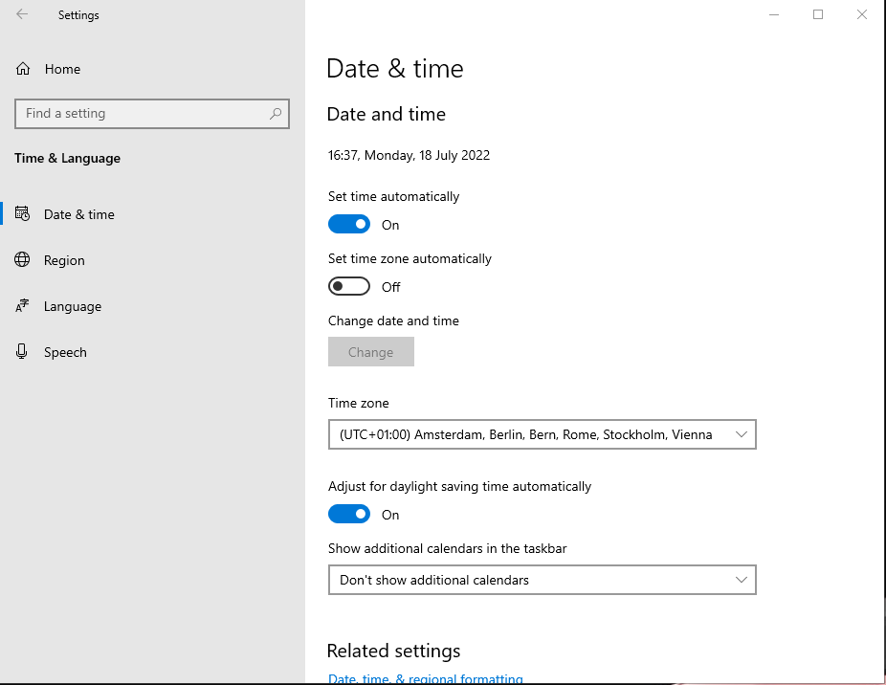
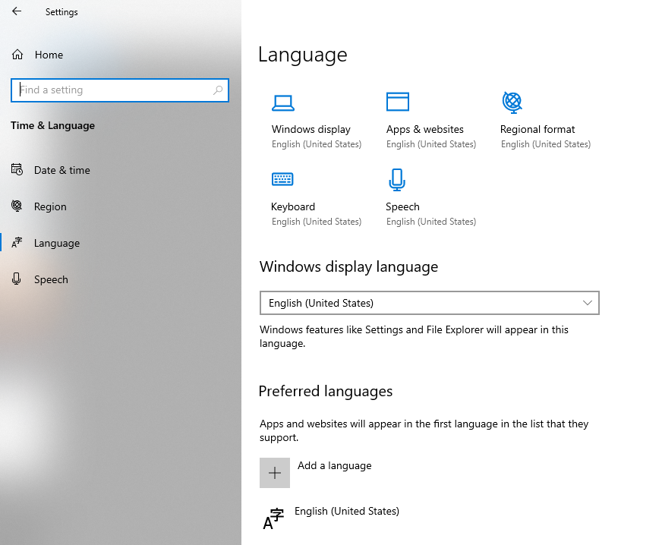
1
Basic Setup
Step | P R O C E D U R E
7 | In the Date & Time Tab, change time Zone to Eastern Time (Photo # 7)
8 | In the Language tab, change Windows, Apps, Regional Format, Keyboard, and Speech to English (Photo # 8) Changes can be made by clicking on the icon and adjusting language in pull down window
7
8

Slide 10
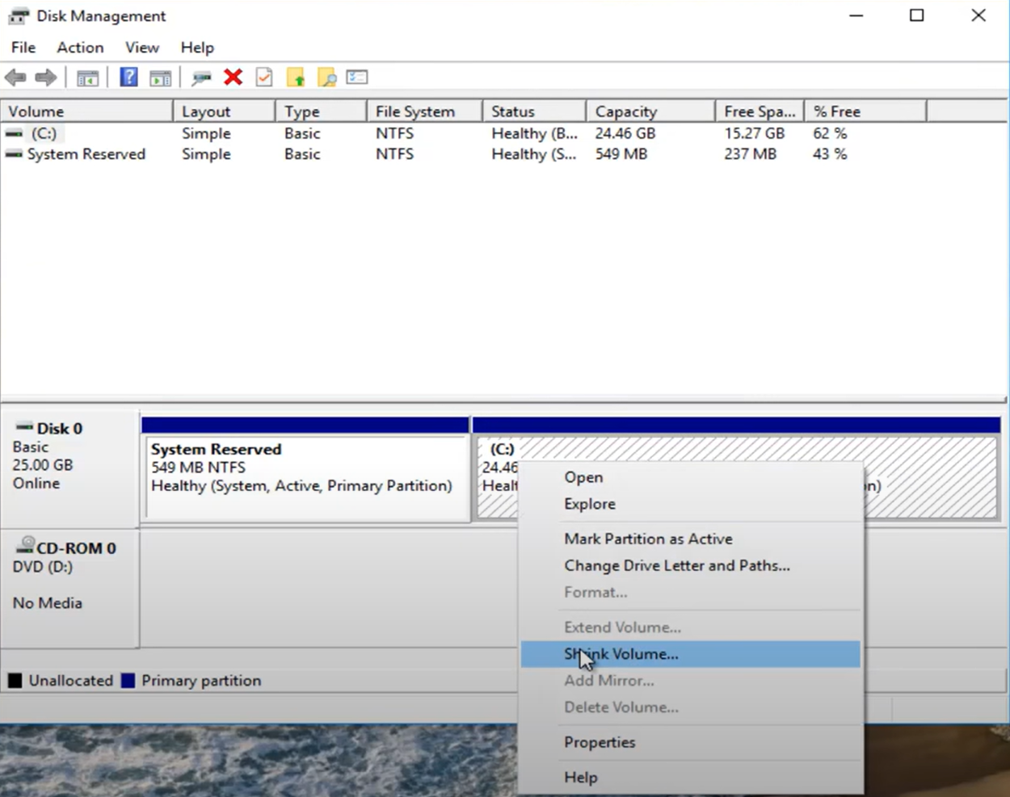
1
Drive Partition
Step | P R O C E D U R E
9 | Click the start window, and type “Create and Format Hard Disk Partitions” Hit Enter and the Disk Management window will open up.
10 | Right Click on the (C:) drive and select “Shrink Volume” (Photo # 9) Shrink the 52000mb from the C Drive, then click “Shrink”
9

Slide 11
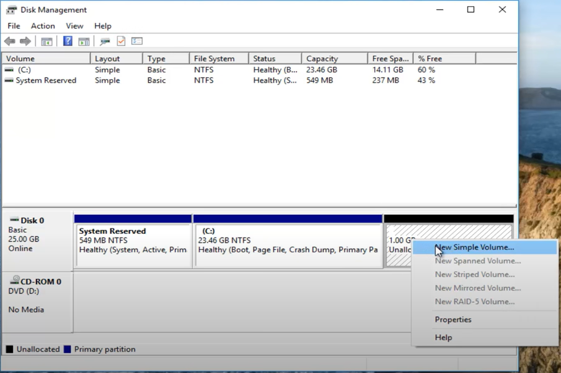
1
Drive Partition
Step | P R O C E D U R E
11 | Right Click on new partition and select “New Sample Volume” (Photo # 10)
12 | Assign the new partition to the letter “D” then click Next Change the name of the drive from New Volume to “Data”
10

Slide 12
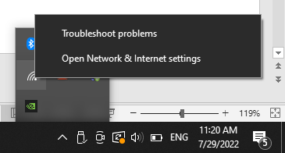
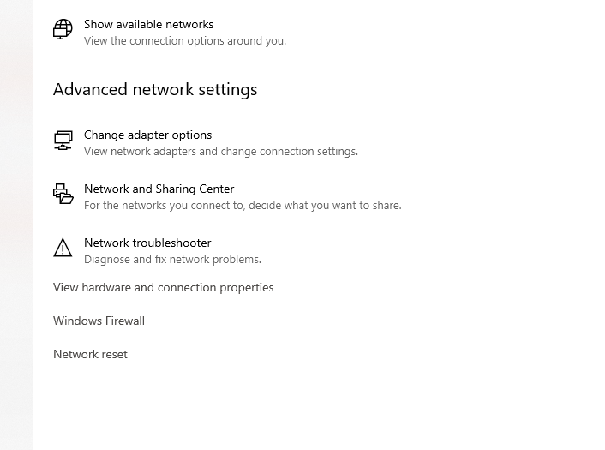
1
IP Address Setup
Step | P R O C E D U R E
13 | Right click on the internet icon Click on Open Network & Internet Settings (Photo # 11) Click on Change Adapter Options (Photo # 12)
11
12

Slide 13
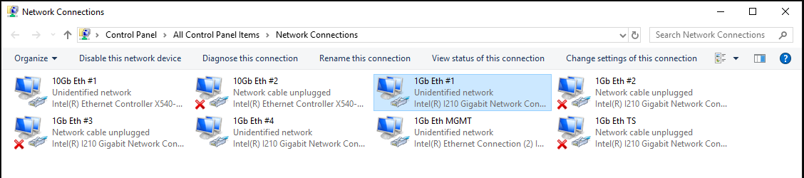
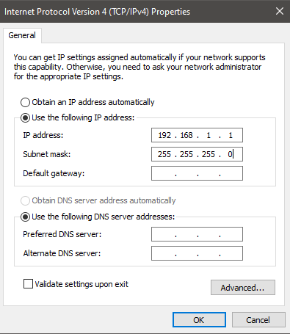
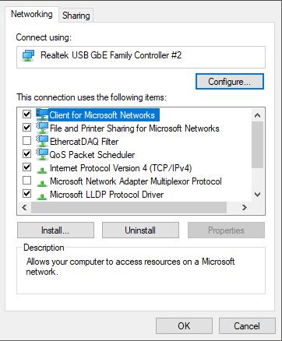
1
IP Address Setup
Step | P R O C E D U R E
14 | Right click on 1Gb Eth #1 (Photo #13), Click on Properties, double click “Internet Protocol Version 4” (Photo #14), Check the bubble saying “Use the following IP address” (Photo #15)
13
15
14

Slide 14
5
IP Address Setup
Step | P R O C E D U R E
15 | Change IP Address and Subnet Mask to the following (Photo # 16) IP Address: 192.168.1.1 Subnet Mask: 255.255.255.0
16 | Repeat step 14 for all the network connections. 1Gb Eth #1 – 192.168.1.1 1Gb Eth #2 – 192.168.2.1 1Gb Eth #3 – 192.168.3.1 1Gb Eth #4 – 192.168.4.1 10Gb Eth #1 – 192.167.10.1 10Gb Eth #2 – 192.168.20.1 1Gb Eth MGNT – 192.168.0.14 Note the Subnet Mask will be 255.255.255.0 for all connections
16

Slide 15
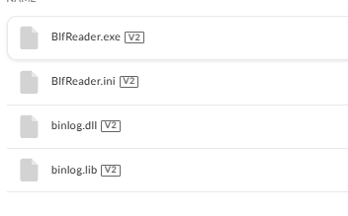
10
Software download
Step | P R O C E D U R E
17 | Transfer the “New Eve Software” from your storage device to the Downloads folder on the Eve Kit.
18 | Open the BlfReader folder and double click on BlfReader.exe file, and it will begin downloading. (Photo # 17)
17

Slide 16
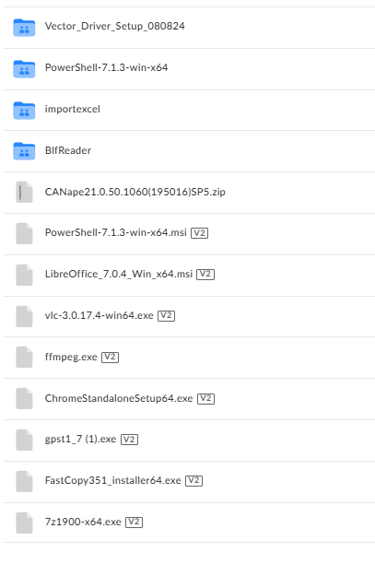
9
Software download
Step | P R O C E D U R E
19 | Repeat step 18 for Powershell-7.1.3-win-x64.msi LibreOffice_7.0.4_Win_x64.mis vlc-3.0.17.4-win64.exe ffmpeg.exe ChromeStandaloneSetup64.exe Gpst1_7 (1).exe FastCopy351_Installer64.exe 7z1900-x64.exe (Photo # 18)
18

Slide 17
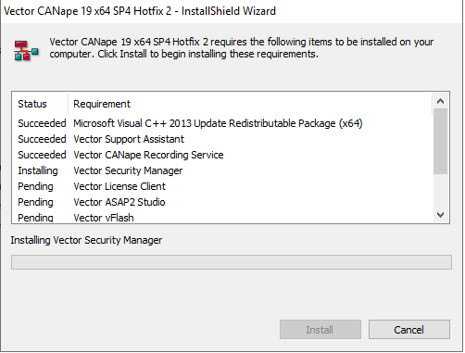
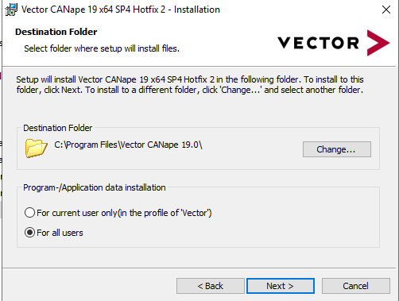
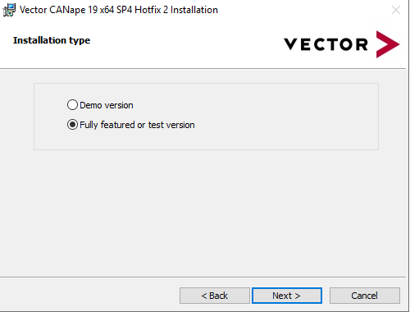
5
Software download
Step | P R O C E D U R E
20 | Unzip and download the CANape21.0 File. Double click Setup.exe to begin install
21 | Install to C:\Program Files\Vector CANape21.0 (Photo # 19) Select the Fully Featured or Test Version (Photo # 20) Note the Eve Kit may restart a couple times during install
21
19
20

Slide 18
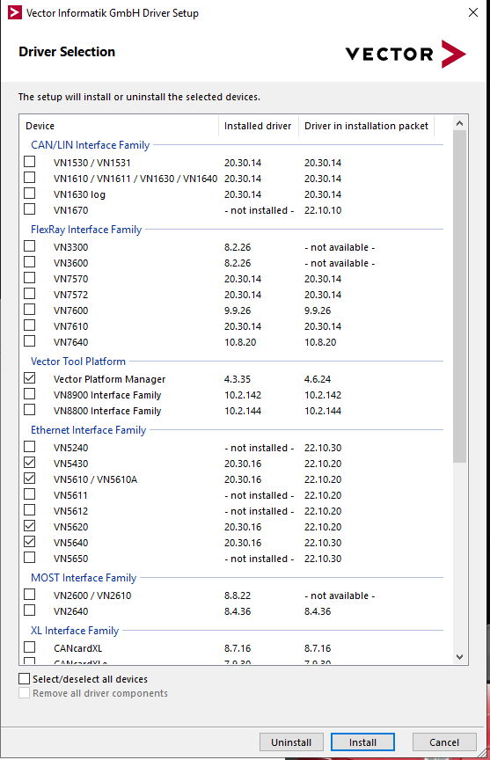
1
Software download
Step | P R O C E D U R E
22 | Vector_Driver_Setup_080824 > Vector_Driver_Setup_24_20_2 > Drivers Double click on setup.exe to download the vector tools
23 | Check the boxes to install the following drivers VN1530/VN1531 VN1610/VN1611/VN1630/VN1640 VN1670 VN5650 Vector Time Sync Service GNSS (Photo # 21)
21

Slide 19
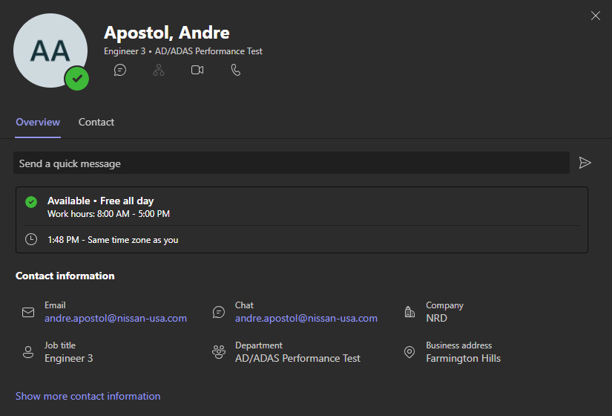
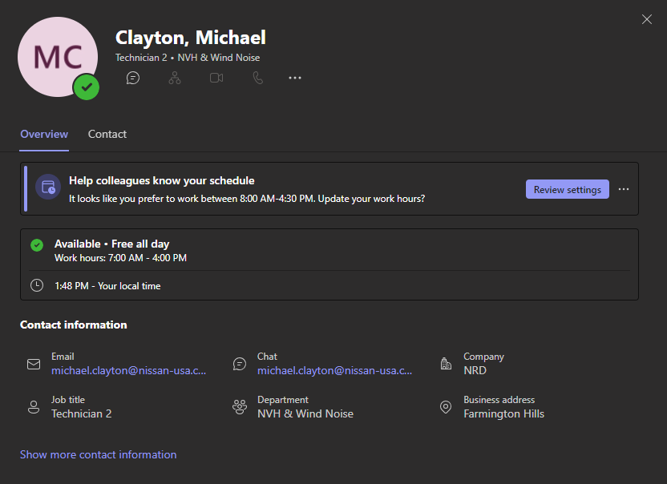
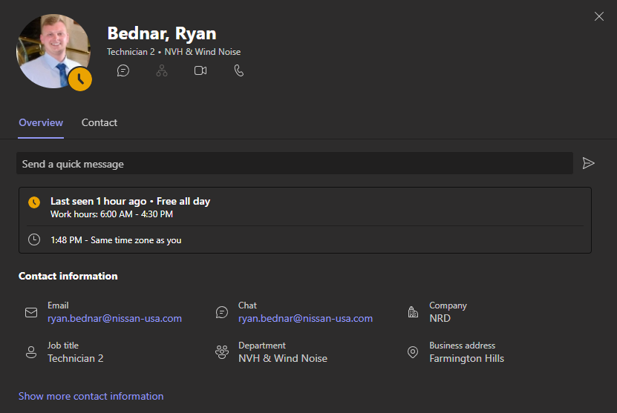
1
Vector License Client
Step | P R O C E D U R E
24 | Work with Andre Apostol, Ryan Bednar, or Michael Clayton to install Vector License to Eve Kit (Photo # 22)
22

Slide 20
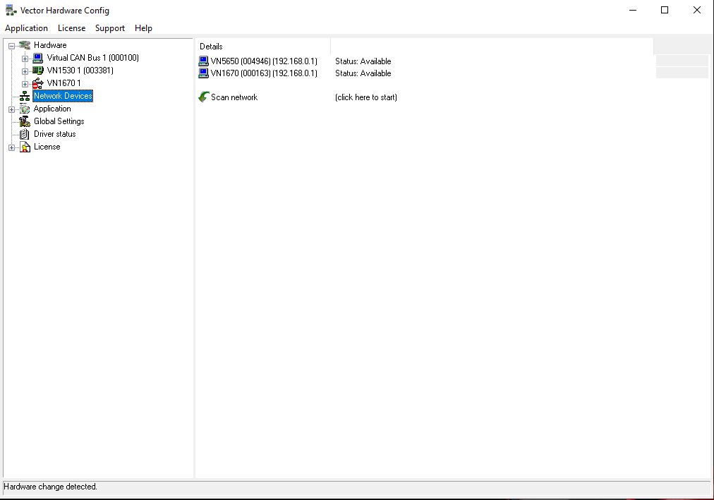
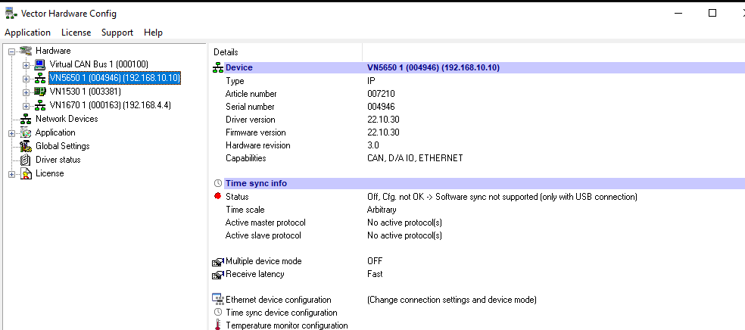
1
Vector Hardware
Step | P R O C E D U R E
25 | Open Vector Hardware Config
26 | In the Network Devices tab, make sure both the VN5650 and VN1670 are available. If they are not available, click the Scan Network icon, once available, right click and select connect on each device. (Photo # 23)
27 | Right click each deice to change IP Address and Mode. VN1670 – Mode: Static, IP: 192.168.4.4 VN1670 – Mode: Static, IP: 19.168.10.10
23

Slide 21
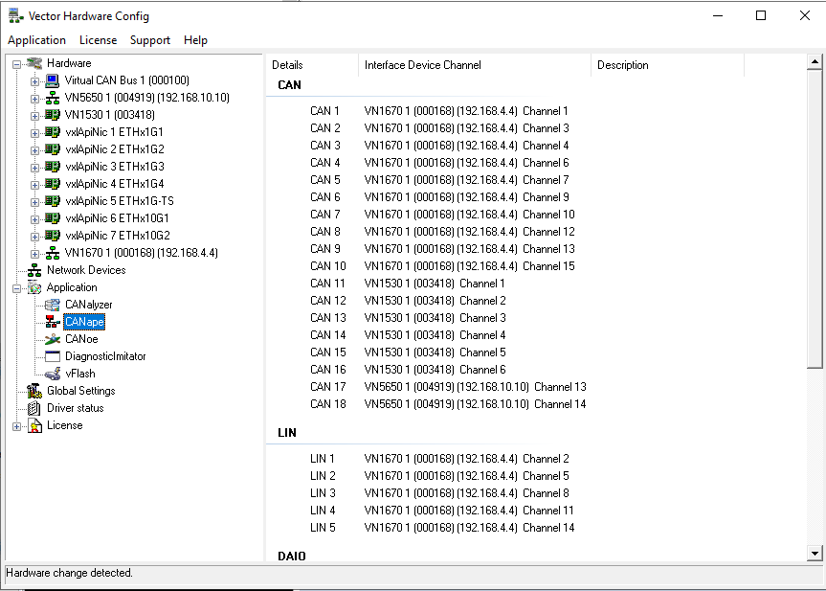
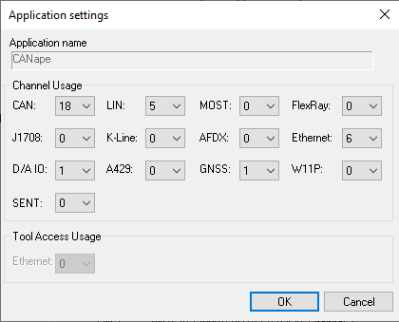
1
Vector Hardware
Step | P R O C E D U R E
28 | Expand the Application tab
29 | Right click on CANape and select Application Channel Usage (Photo # 24) Assign CAN to 18 Channels and LIN to 5 Channels then click “OK” (Photo # 25)
30 | Right click each can channel and assign each can channel as show in Photo # 24 CAN 1-10 = VN1670 CAN 11-16 = VN1530 CAN 17-18 = VN5650
25
24

Slide 22
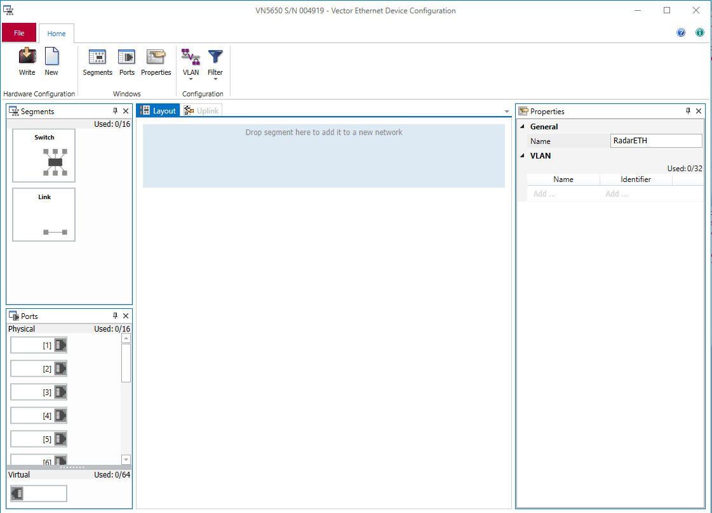
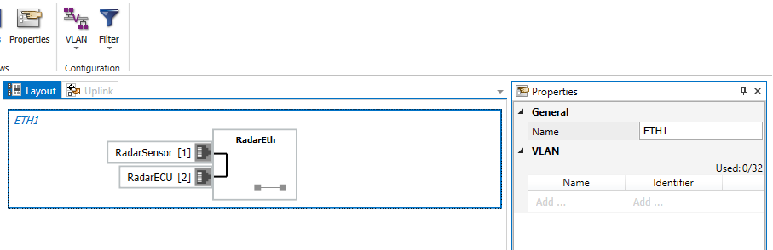
1
Vector Hardware
Step | P R O C E D U R E
31 | Right click on VN5650 and select Ethernet Device Configuration
32 | Drag the “Link” Segment and Physical ports 1 and 2 to the light blue box in the center of the screen (Photo # 26)
33 | 1 Rename the name to ETH1 2 Rename Port 1 to RadarSensor 3 Rename Port 2 to RadarECU 4 Rename Link to RadarEth (Photo # 27)
4
2
1
3
26
27

Slide 23
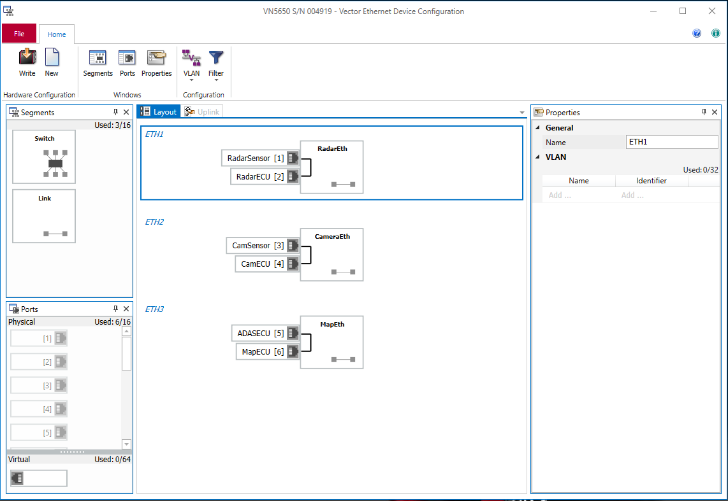
10
Vector Hardware
Step | P R O C E D U R E
34 | Repeat steps 26 and 27 for the Camera and Map (Photo # 28)
35 | 1 Note Camera will use Ports 3 and 4 Rename the name to ETH2 Rename Port 3 to CamSensor Rename Port 4 to CamECU Rename Link to CameraEth
36 | 2 Note Map will use ports 5 and 6 Rename the name to ETH3 Rename Port 5 to ADASECU Rename Port 6 to MapECU Rename Link to MapEth
1
2
28

Slide 24
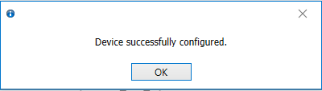
1
Vector Hardware
Step | P R O C E D U R E
37 | Click “Write” in the top left corner to write the configuration to the VN5650. (Photo # 29) Once complete a popup will say “Device Successfully ConPhoto #d” (Photo # 30)
29
30

Slide 25
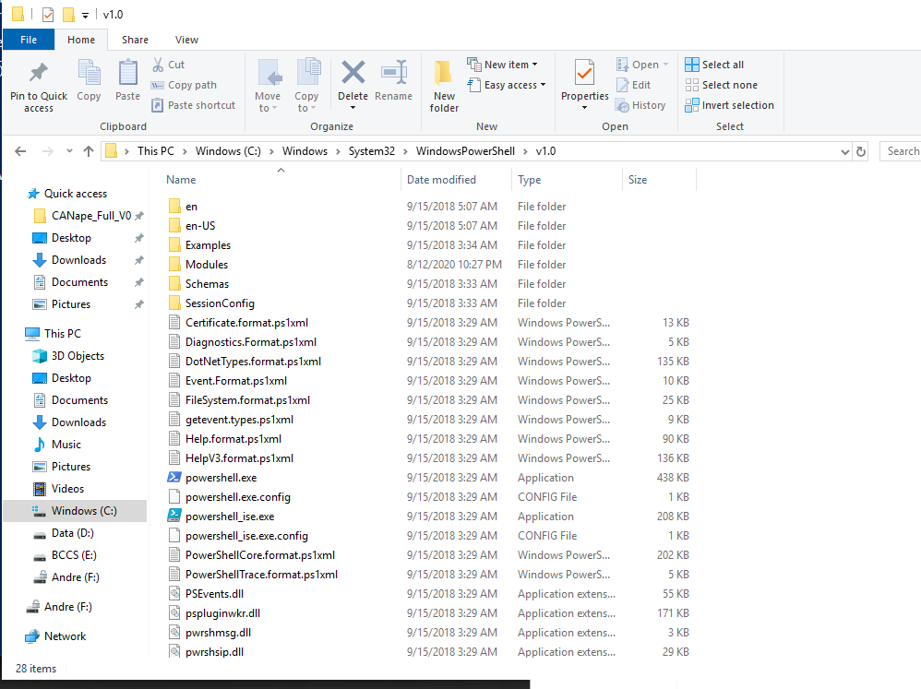
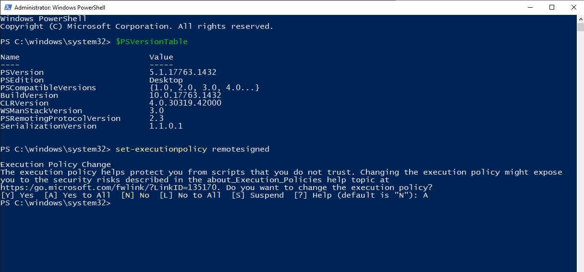
1
Powershell
Step | P R O C E D U R E
38 | Open File Explore folder on task bar
39 | This PC > Windows(C:) > System32 > WindowsPowerShell > v1.0 Scroll down to Powershell.exe, right click and Run and Administrator (Photo # 31)
40 | In the command window (Photo # 32) (1) Type $PSVersionTable *enter* Ensure “PSVersion” = 5.1 (2) Type set-executionpolicy remotesigned *enter* type “A” = Yes to All
1
2
32
31

Slide 26
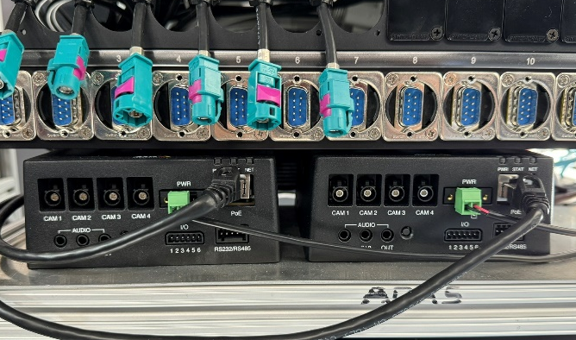
2
Axis Hardware
Step | P R O C E D U R E
41 | Unplug the green power connector from the second Axis Encoder (Photo # 33)
Power connector
33
Encoder #1
Encoder #2

Slide 27
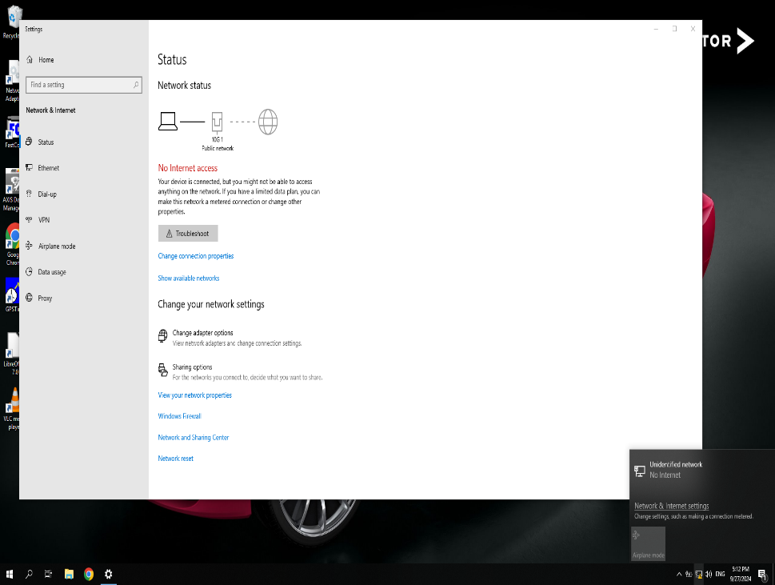
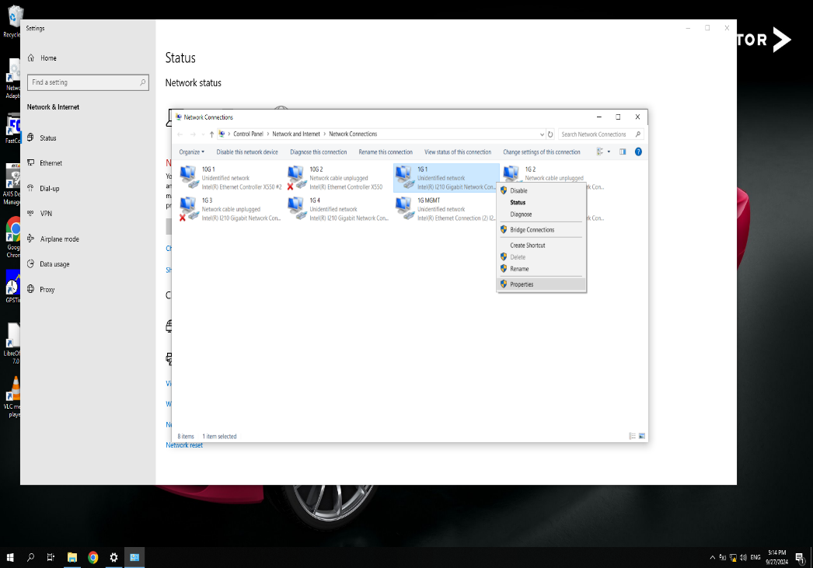
5
Axis Hardware
Step | P R O C E D U R E
42 | Right click on the network icon in the bottom right to go to network settings (1) . Once in network settings, click on “Change adapter options” (2) (Photo # 34)
43 | Right click on the “1G 1” network and go down to properties. (Photo # 35)
2
34
1
35

Slide 28
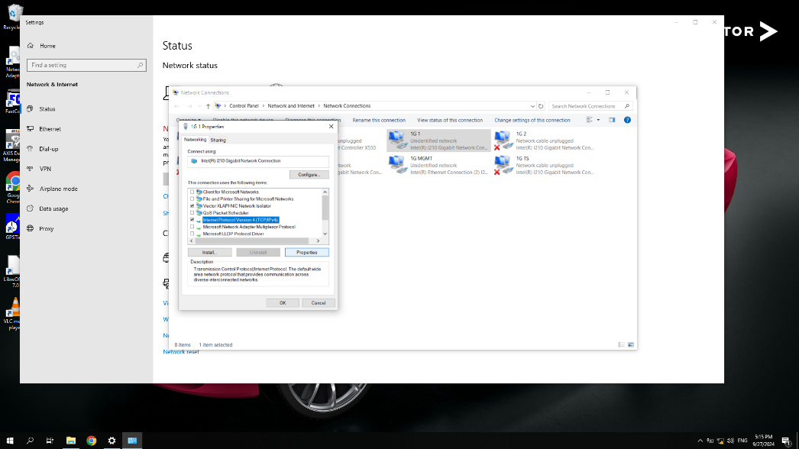
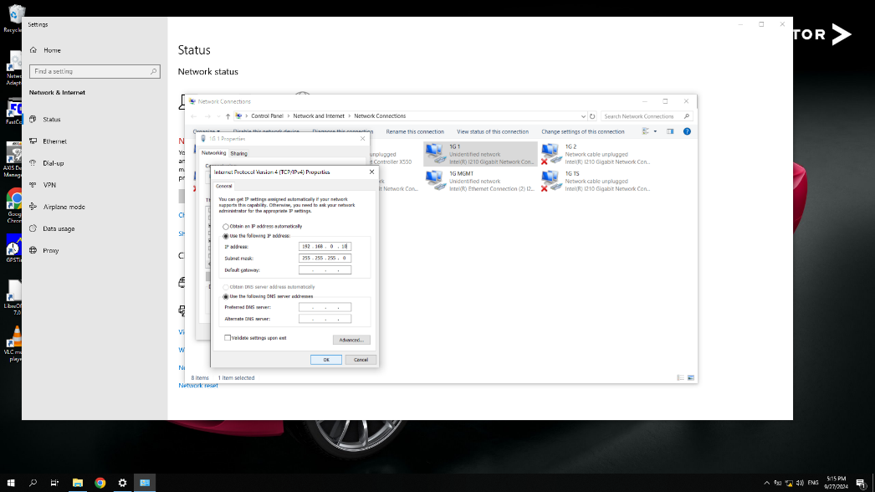
1
Axis Hardware
Step | P R O C E D U R E
44 | Click on “Internet Protocol Version 4 (TCP/IPv4)” then click properties (Photo # 36)
45 | Change the IP Address to 192.168.0.10 and click OK (Photo # 37)
36
37

Slide 29
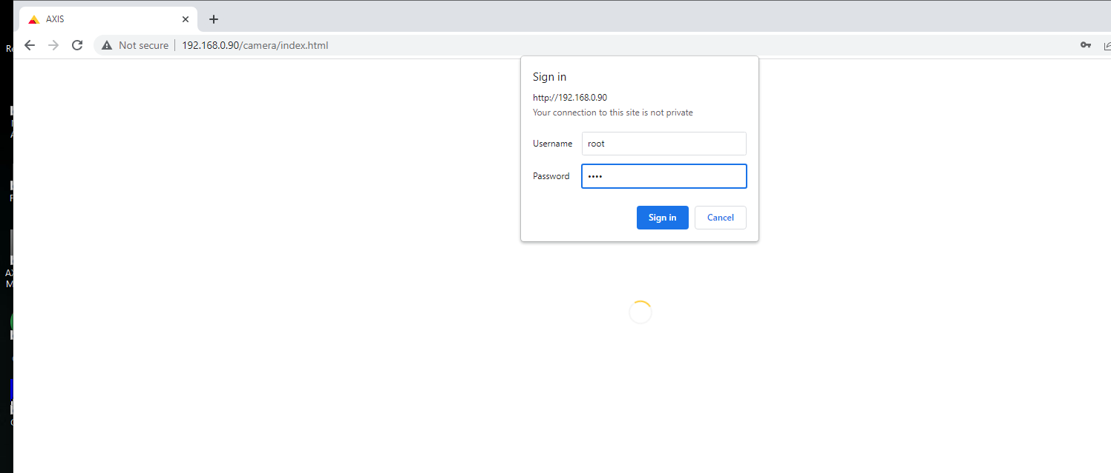
1
Axis Hardware
Step | P R O C E D U R E
46 | Go to google chrome and type in 192.168.0.90 in the search bar, This will take you to the Axis log in page. For Username: root For Password: root You will then be sent back to the sign in page (Photo # 38)
root
38

Slide 30
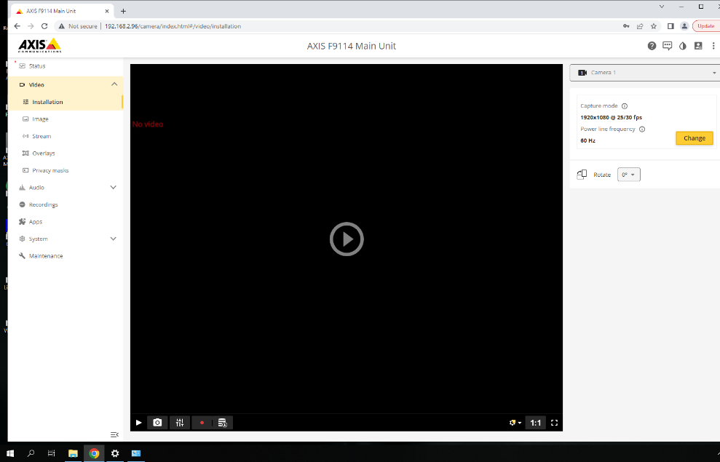
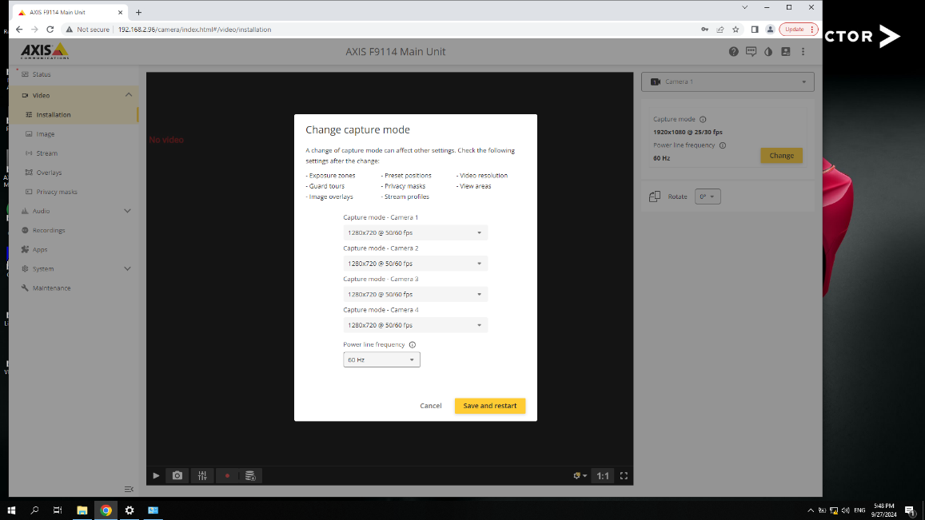
5
Axis Hardware
Step | P R O C E D U R E
47 | Click the yellow Change (1) button on the right side to change the video display settings. (Photo # 39)
48 | Change all video settings to 1280x720 @50/60 fps Click Save and restart. This will prompt the Axis Encoder to restart (Photo # 40)
1
39
40

Slide 31
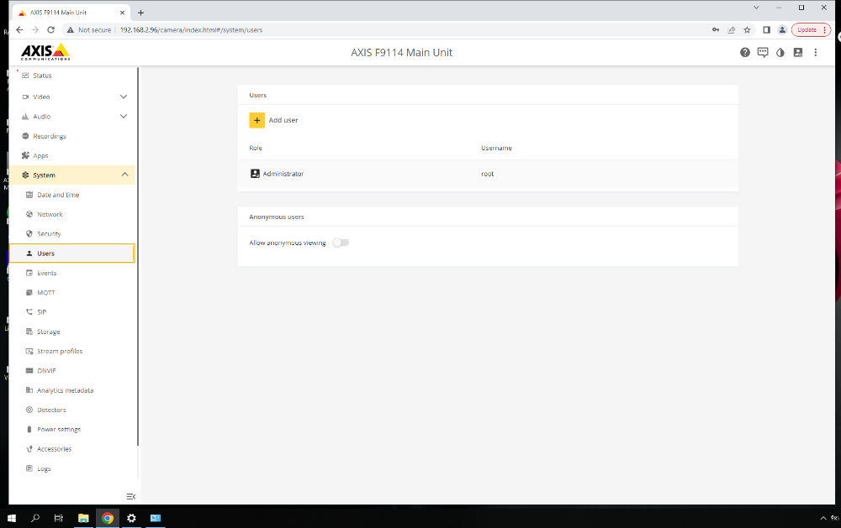
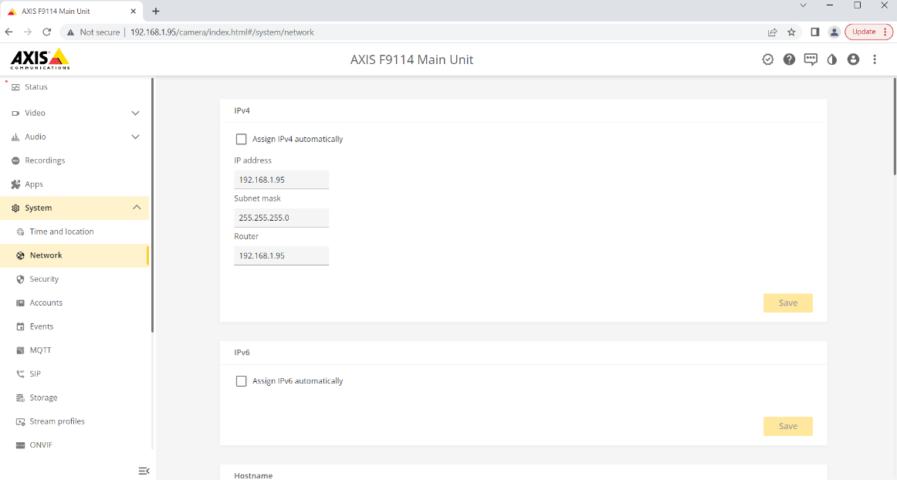
1
Axis Hardware
Step | P R O C E D U R E
49 | Under Systems tab, go to Users and Allow Anonymous Viewing (Photo # 41)
50 | Under Systems tab, go to Network, Uncheck Assign IPv4 Automatically (1) Change the IP Address to 192.168.1.95 and click Save. (Photo # 42)
1
41
42

Slide 32
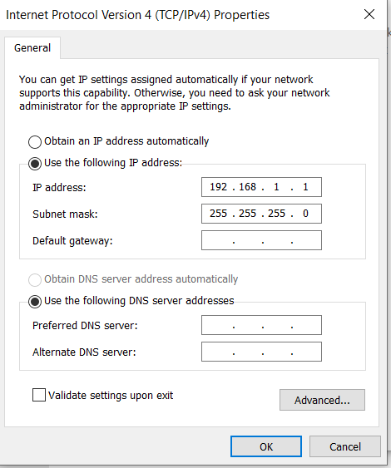
1
Axis Hardware
Step | P R O C E D U R E
51 | Go back to the network adapters for 1G 1, click on “Internet Protocol Version 4 (TCP/IPv4)” then click properties (Photo # 43)
52 | Change the IP Address back to 192.168.1.1 and click OK (Photo # 44)
43
44

Slide 33
5
Axis Hardware
Step | P R O C E D U R E
53 | Unplug the green power connector from the first Axis Encoder and plug power connector in for second Axis Encoder (Photo # 45)
Power connector
45
Encoder #1
Encoder #2

Slide 34
20
Axis Hardware
Step | P R O C E D U R E
54 | Repeat steps 36-45 but for Network 1G 2. - When you reach step 43 the IP address will be 192.168.2.96 - When you reach step 45 the IP address will be 192.168.2.1
55 | If there is a 3rd Axis Encoder; Repeat steps 36-45 but for Network 1G 3. - When you reach step 43 the IP address will be 192.168.3.97 - When you reach step 45 the IP address will be 192.168.3.1
End of Test

Slide 35
APPENDIX

Slide 36
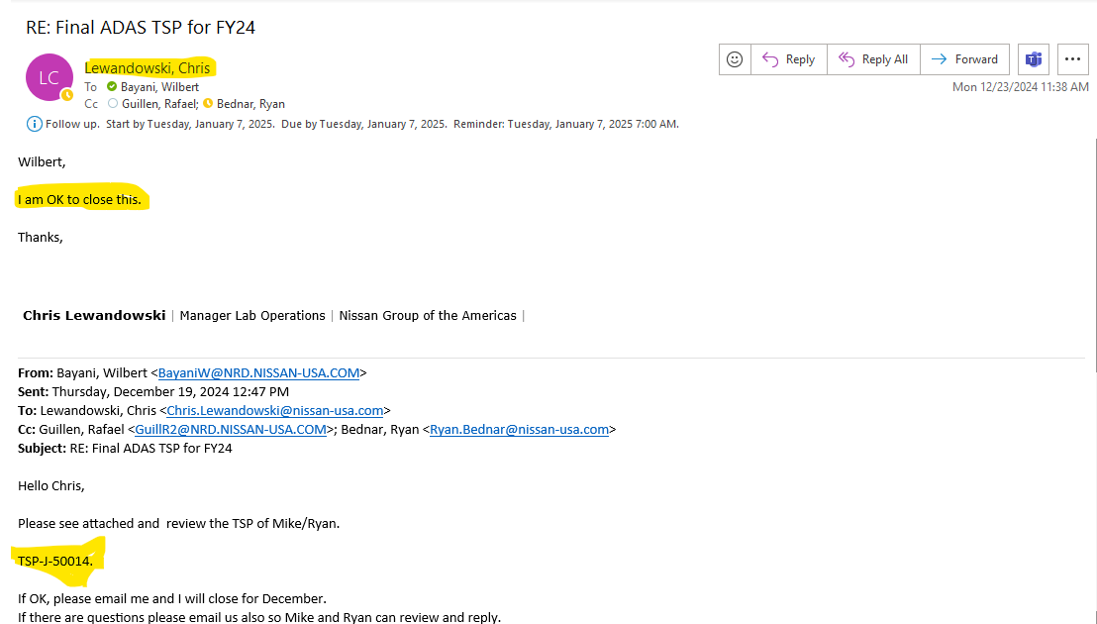

Slide 38
TSP-J-5014
Eve Kit Software Installation

